Slide 1
Operating Systems CS2006
Chapter: 4
Threads
1
CS-2006 Operating Systems
1

Slide 2
Background

Slide 3
Basic concepts
Multiprogramming: Many processes one CPU. Interleaving between multiple processes. Process relinquish CPU itself.
Multiprocessing: refers to more than one CPU. Systems can be both multiprogramming and multiprocessing at the same time.
Multitasking: refers to modern operating systems doing preemption for switching processes/threads. OS gives a time quantum to each process/thread.
Time sharing: When CPU time is being shared between processes, it is called time sharing system. Multiprogramming & multitasking systems are time sharing systems.
Multithreading: is an execution model that allows a single process to have multiple code segments (threads) that run concurrently within the context of that process.

Slide 4
Motivation
Most modern applications are multithreaded
Threads run within application
Multiple tasks with the application can be implemented by separate threads
MS Word
One thread for spell checking
One thread for output of keystrokes
Process creation is heavy-weight while thread creation is light-weight
Increases efficiency
Kernels are generally multithreaded

Slide 5
Introduction
Each process has
Own Address Space
Single thread of control
A process model has two concepts:
Resource grouping
Execution
Sometimes it is useful to separate them
CS-2006 Operating Systems
5

Slide 6
Unit of Resource Ownership
A process has an
Address space
Open files
Child processes
Accounting information
Signal handlers
If these are put together in a form of a process, can be managed more easily
CS-2006 Operating Systems
5

Slide 7
Unit of Dispatching
Path of execution
Program counter: which instruction is running
Registers:
holds current working variables
Stack:
Contains the execution history, with one entry for each procedure called but not yet returned
State
Processes are used to group resources together
Threads are the entities scheduled for execution on the CPU
Threads are also called lightweight process (LWP)
CS-2006 Operating Systems
5

Slide 8
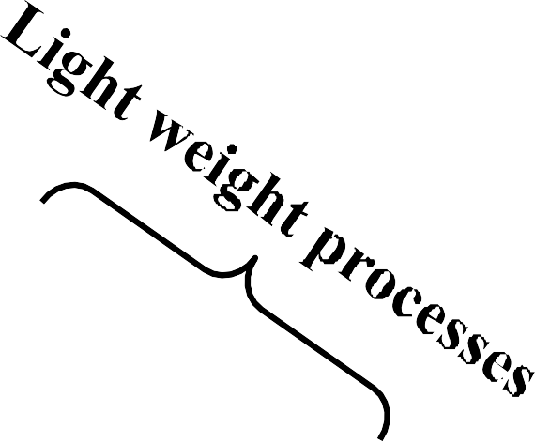
Its better to distinguish between the two concepts
Address space/Global Variables Open files
Child processes Accounting info Signal handlers Program counter Registers
Stack State
Heavy weight process
In case of multiple threads per process
Unit of Resource
Split
Unit of Dispatch
Address space/Global Variables Open files Child processes Accounting Info
Signal Handlers ₈ CS-2006 Operating Systems |  | Share
Program
Co
unter gisters ck
te
Program Counter R
Re
Sta
egisters tack tate
Sta
Program Counter
S
S
Registers Stack State

Slide 9



















Multithreaded Server Architecture

Slide 10
What are threads?

Slide 11
Thread
A thread is a flow of execution through the process code.
A thread will always belong to some process.
A process can have multiple threads but starts with one only
Threads share:
Same data as that of its process
Same code as that of its process
Same files as that of its process
Each thread has its own
Register.
Stack.
Program Counter.

Slide 12
























Single and Multithreaded Processes

Slide 13
Benefits
Responsiveness – may allow continued execution if part of process is blocked, especially important for user interfaces
Resource Sharing – threads share resources of process, easier than shared memory or message passing
Economy – cheaper than process creation, thread switching lower overhead than context switching
Scalability – process can take advantage of multiprocessor architectures

Slide 14
Process vs. Thread
■ | Process is heavy weight or resource intensive. | ■ | Thread is light weight, taking lesser resources than a process.
■ | Process switching needs interaction with operating | ■ | Thread switching does not
 | system. |  | need to interact with operating
 |  |  | system.
■ | In multiple processes each process operates | ■ | One thread can read, write or
 | independently of the others. |  | change another thread's data.

Slide 15
Thread Properties

Slide 16
Multicore Programming
Multicore or multiprocessor systems offer real speed up if multiple threads are used
Programmers must accurately use threads
Divide independent problems and assign to threads
Keep a balance in dividing activities, do not overburden one or more threads
Split Data too, so threads can work in parallel
Data should be split properly, so that dependency among threads remains minimum
Testing and debugging of the multi threaded applications is difficult
Parallelism implies a system can perform more than one task simultaneously
Concurrency enables more than one task making progress

Slide 17



















Concurrency vs. Parallelism
■ Concurrent execution on single-core system:
■ Parallelism on a multi-core system:

Slide 18
Multicore Programming (Cont.)
Types of parallelism
Data parallelism – distributes subsets of the same data across multiple cores, same operation on each
Task parallelism – distributing threads across cores, each thread performing unique operation
As # of threads grows, so does architectural support for threading
CPUs have cores as well as hardware threads
Consider Oracle SPARC T4 with 8 cores, and 8 hardware threads per core
18
CS-2006 Operating Systems

Slide 19
User Threads and Kernel Threads
User threads - management done by user-level threads library
The thread library contains code for creating and destroying threads, for passing message and data between threads, for scheduling thread execution and for saving and restoring thread contexts
Three primary thread libraries:
POSIX Pthreads
Windows threads
Java threads
Kernel threads - Operating System managed threads acting on kernel
Examples – virtually all general purpose operating systems, including:
Windows
Solaris
Linux
Tru64 UNIX
Mac OS X

Slide 20
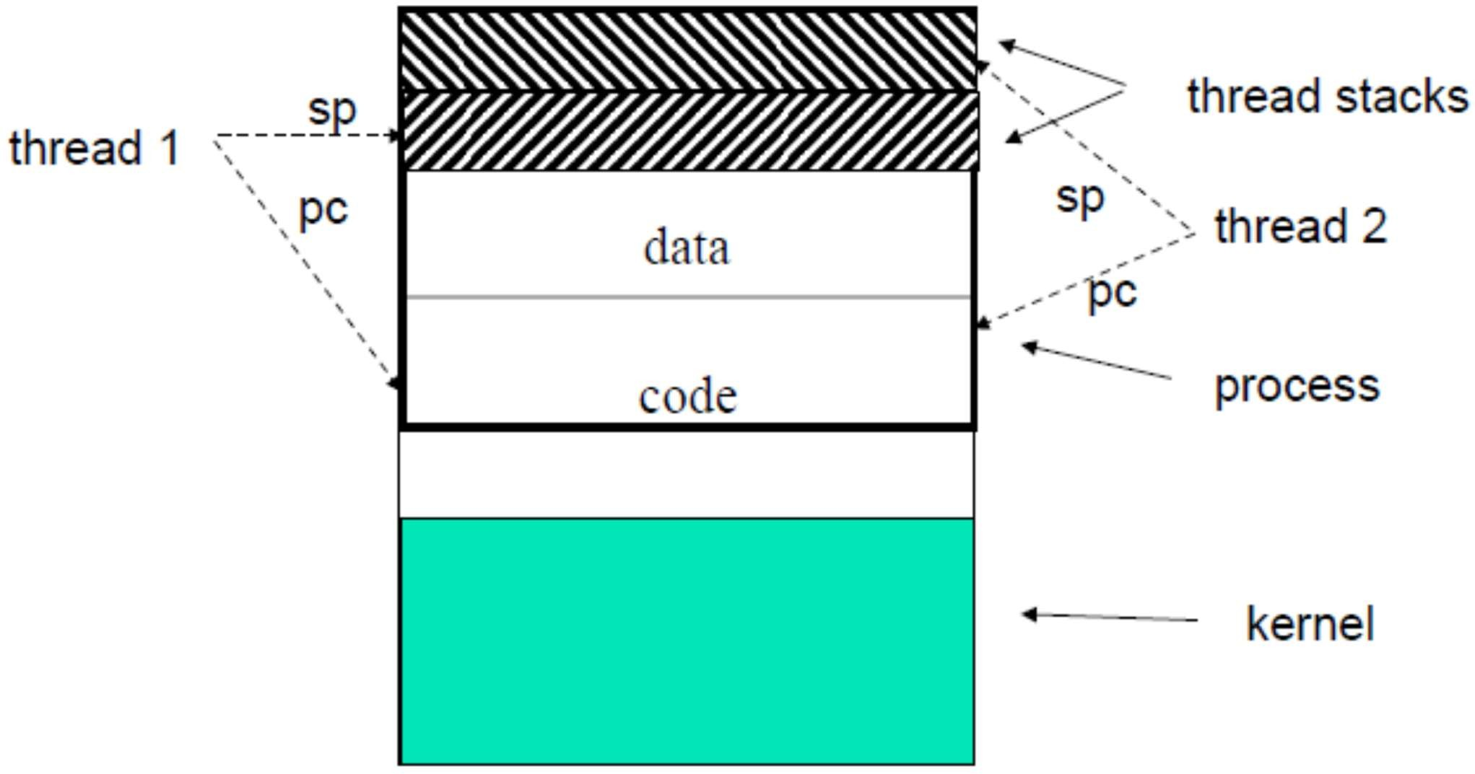
User-Level Thread Implementation
20
CS-2006 Operating Systems

Slide 21
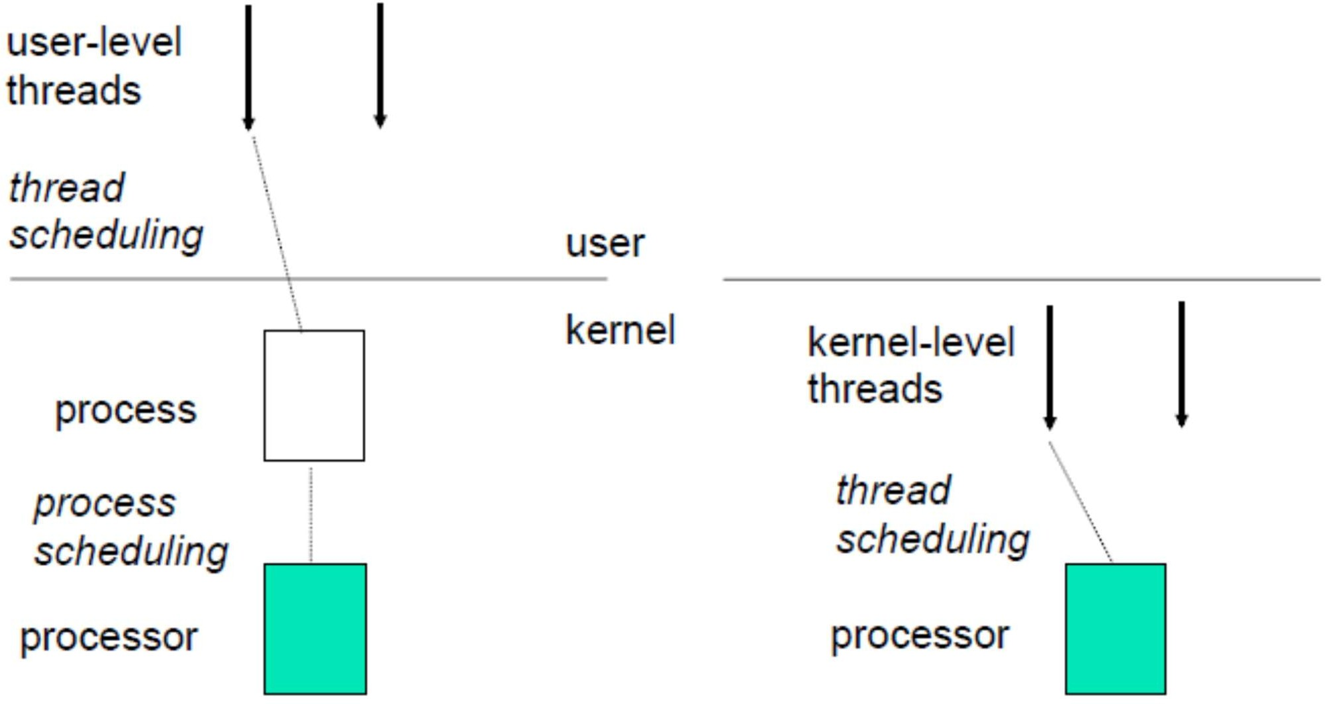
User-Level vs. Kernel-Level Threads
21
CS-220 Operating Systems

Slide 22
User-level threads vs. kernel-level threads
■ | User-level threads are faster to create and manage. | ■ | Kernel-level threads are slower to create and manage.
■ | Implementation is by a thread | ■ | Operating system supports
 | library at the user level. |  | creation of Kernel threads.
■ | OS doesn’t recognize user | ■ | OS recognizes kernel-level
 | level threads. |  | threads
■ | Multi-threaded applications | ■ | Kernel routines themselves
 | cannot take advantage of |  | can be multithreaded.
■ | multiprocessing If one user level thread | ■ | If one kernel thread perform blocking operation then
 | perform blocking operation |  | another thread can continue
 | then entire process will be |  | execution.
 | blocked.

Slide 23
Multithreading Models
User-level threads can be implemented using any of the three models:
Many-to-One
One-to-One
Many-to-Many

Slide 24

Many-to-One
Synonym of user-level threads
Many user-level threads mapped to single kernel thread
One thread blocking causes all to block
Multiple threads may not run in parallel on muticore system because only one may be in kernel at a time
Few systems currently use this model
Examples:
Solaris Green Threads
GNU Portable Threads

Slide 25





One-to-One
Creating a user-level thread creates a kernel thread
More concurrency than many-to-one
One user-level thread is mapped onto one kernel level thread.
Even if one thread is blocked, others will still run
Allows multiple threads to run on multiprocessor system
Number of threads per process sometimes restricted due to overhead
Examples
Windows
Linux
Solaris 9 and later

Slide 26



Many-to-Many Model
Allows many user level threads to be mapped to many kernel threads
The number of kernel level threads maybe equal to or less than user level threads
Allows the operating system to create a sufficient number of kernel threads
Many-to-one: suffered from lack of concurrency
One-to-one: suffered from overhead of too many kernel level threads
Many-to-many suffers from none

Slide 27
Threads In Action

Slide 28
C function call vs. thread creation
int x;
---
---
pthread_create()
2
int x;
---
---
2
1
1
2
function()
3
4

Slide 29
Pthread Operations
POSIX function | description
pthread_create | create a thread
pthread_detach | set thread to release resources
pthread_equal | test two thread IDs for equality
pthread_exit | exit a thread without exiting process
pthread_kill | send a signal to a thread
pthread_join | wait for a thread
pthread_self | find out own thread ID

Slide 30
Practical work (explanation)
pthread_create(pthread_t* , NULL, void*, void*)
First Parameter is pointer of thread ID it should be different for all threads.
The second argument points to a pthread_attr_t structure whose contents are used at thread creation time to determine attributes for the new thread. Null means use default attr.
Third perimeter is address of function which we are going to use as thread.
Forth parameter is argument to function. Only one is allowed.

Slide 31
Pthread_create Returning value
Returned value:
If successful, pthread_create() returns 0.
If unsuccessful, pthread_create() returns -1 and sets errno to one of the following values:

Slide 32
Practical work (explanation)
pthread_join(i pthread_t , void**)
Pthread join is used in main program to wait for the end of a particular thread.
First parameter is Thread ID of particular thread
Second Parameter is used to catch return value from thread.

Slide 33
pthread_join - wait for thread termination
RETURN VALUE
If successful, the pthread_join() function returns zero. Otherwise, an error number is returned to indicate the error.
The pthread_join() function suspends execution of the calling thread until the target thread terminates, unless the target thread has already terminated. On return from a successful pthread_join() call with a non-NULL value_ptr argument, the value passed to pthread_exit() by the terminating thread is made available in the location referenced by value_ptr. When a pthread_join() returns successfully, the target thread has been terminated.

Slide 34
Exit() function
The pthread_exit() function terminates the calling thread and makes the value value_ptr available to any successful join with the terminating thread. Any cancellation cleanup handlers that have been pushed and not yet popped are popped in the reverse order that they were pushed and then executed.

Slide 35
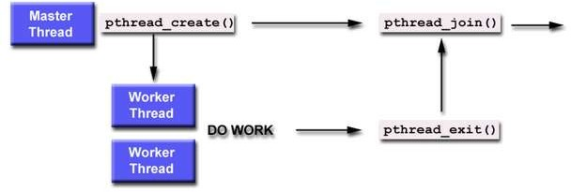

Slide 36
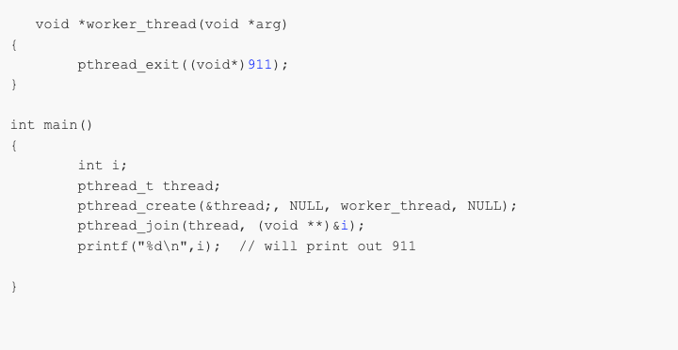

Slide 37
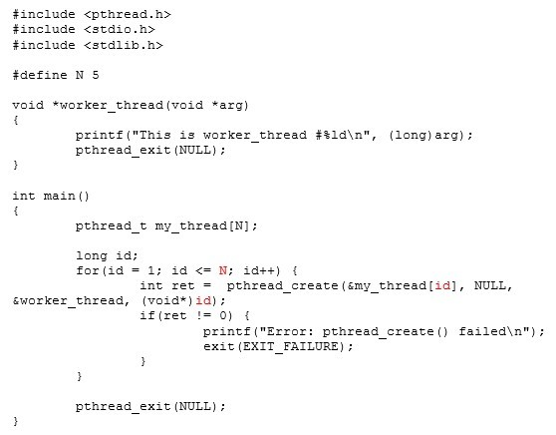

Slide 38

Output

Slide 39
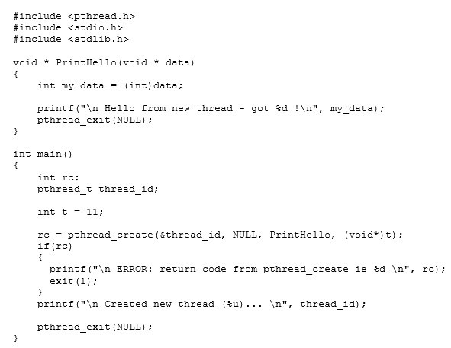

Slide 40
Output
Created new thread (4) ... Hello from new thread - got 11

Slide 41
Questions
What happens when a thread calls an exit() function?
Can a function that is a part of the program be called from a thread?
What happens when you call a fork() in a thread?
What happens when you call pthread_exit() in the main thread?

Slide 42
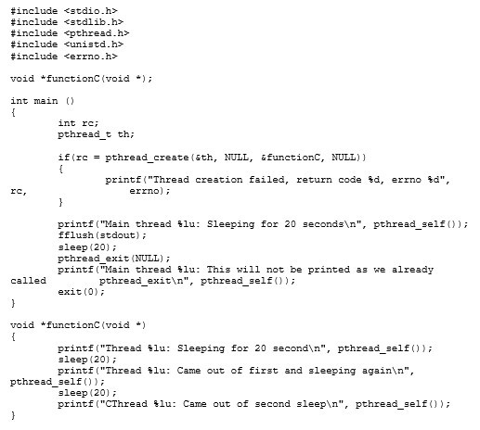

Slide 43

Output

Slide 44
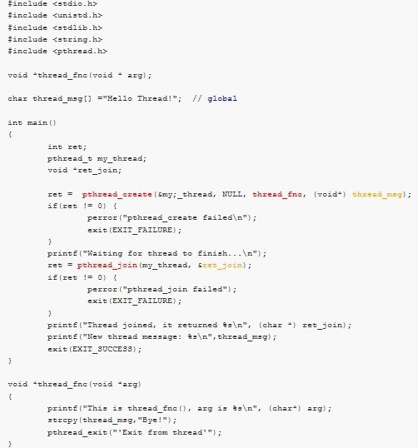

Slide 45

Output

Slide 46
Practice Problem
Write a program in which you are going to create a thread. The main thread will pass an integer value N to the newly spawned thread. This thread will sum the numbers starting from 1 till the number N. The main thread will display the updated sum. Remember that the main thread will have to wait for the spawned thread to complete its work.
SKELETON:
int sum;
void *runner(void *param); main()
{
pthread_create(tid, attr, runner, int_arg); Pthread_join(tid);
}
void * runner(void *param)
{
sum… pthread_exit(sum);
}

Slide 47
Practice
Write a program that gets the following problem solved in two threads.
■ (3 * 10) + (5 * 4)
■ First half via thread 1 and second half via thread 2
Write the program in which you will search for the two halves of an int array for a value, each half using one thread.

Slide 48
Non-deliverable assignment
Write a program in which you create a thread that calculates the factorial of a number n that is input by a user. The thread attributes must be changed are:
Scope
Scheduling priority
Write a program that prints the first 15 numbers(starting from 1-15) each after a delay of one second using threads
Why do we fork when we can thread?

Slide 49
Example Solution

Slide 50
Solution Practice example_2 1/5
#include <iostream> #include<pthread.h> #include<stdio.h> using namespace std; #include <string.h>
//agruments that we pass in the function
// we create struct if we have to pass multiple arguments
struct arg_struct {
int array[10]={1,2,3,4,5,6,7,8,9,10};
int size=10; int search=11;
};

Slide 51
Solution Practice example_2 2/5
//function that we use in threads
// to search in 1st half
void* myFunc1(void* arguments)
{
struct arg_struct *args = (struct arg_struct *)arguments; int *val_p=args->array;
int *val=new int; int i = 0;
for( i = 0; i < args->size/2; i++){
if(val_p[i]==args->search){
*val=val_p[i];
}
}
pthread_exit( (void*) val); }

Slide 52
Solution Practice example_2 3/5
// to search in 2nd half
void* myFunc2(void* arguments)
{
struct arg_struct *args = (struct arg_struct *)arguments; int *val_p=args->array;
int *val=new int; int i = 0;
for( i = args->size/2; i < args->size; i++){ if(val_p[i]==args->search){
*val=val_p[i];
}
}
pthread_exit( (void*) val); }

Slide 53
Solution Practice example_2 4/5
int main()
{
// createing id for thread pthread_t thread1_id,thread2_id; struct arg_struct thread_var;
// creating threads
if (pthread_create(&thread1_id, NULL, &myFunc1,(void *) &thread_var)==-1)
{
cout<<"Thread Creation Failed!"<<endl; return 1;
}
if (pthread_create(&thread2_id, NULL, &myFunc2,(void *) &thread_var)==-1)
{
cout<<"Thread Creation Failed!"<<endl; return 1;
}
57

Slide 54
Solution Practice example_2 5/5
// variables to store the return value int *ptr_t1_ret,*ptr_t2_ret;
// wait for the end of a particular thread pthread_join(thread1_id, (void**) &ptr_t1_ret); pthread_join(thread2_id, (void**) &ptr_t2_ret);
// display result if(*ptr_t1_ret>0){
cout<<"found in first half of array"; } else if(*ptr_t2_ret>0){
cout<<"found in 2nd half of array"; } else
{cout<<"not found";}
}

Slide 55
Thanks

